Slide 1
NEONATAL HYPOGLYCEMIA AND HYPOCALCEMIA
Dr v sowjanya Bhanu
Senior resident

Slide 2
Introduction
Hypoglycemia is one of most common metabolic problem in neonates.
Persistent hypoglycemia is most likely associated with endocrine disorders and possible neurologic sequelae

Slide 3
Physiology
Glucose provides 60-70% of energy to fetus and newborn.
Fetal glucose is approximately 2/3 of maternal
levels.(Trans placental facilitated diffusion)
Why prone to develop hypoglycemia:-
1.Umblical cord cutting at birth.
2. Inadequate storage of glycogen.
3. Immature adaptive mechanisms.
4. Prone to long term neurological damage.

Slide 4
Lowest value upto 25-40 mg/dl in the first 1 - 2
hours of life.
Stabilize by 65-70 mg/dl by 3-4 hours of
age spontaneously or with feed/intervention

Slide 5
Epidemiology
Incidence: 1.3-3/1000 live birth.
Incidence varies with definition, population, method, timing of feed and type of glucose estimation method.
Plasma value is 10-15% higher than blood glucose value.
Incidence is higher in at risk neonates (LPT>SGA>IDM>LGA)

Slide 6
DEFINITION
Clinical definition:-
Based on symptoms associated with hypoglycemia and resolution of symptoms when glucose restored in normal range.
Sometimes development of signs and symptoms may be late.

Slide 7
Operational Threshold of cornbalth:
Glucose level at which intervention should be considered.
It is an indication of action not diagnostic of disease or abnormality.
It is based on clinical experience and analysis of available evidences.

Slide 8
Healthy term:
<24 hrs: 30-35 mg/dl at one time
45mg/dl if persist after feeding or recurs.
>24 hrs: 45-50 mg/dl
Symptomatic: 45 mg/dl
Asymptomatic with risk factor: 36 mg/dl
Any baby with <20-25 mg/dl

Slide 9
Indications for routine screening
LBW infants(<2.5 kg)
Preterm (<35 weeks)
SGA (BW<10th centile),L G A, I D M
Rh hemolytic disease
Post exchange transfusion
Infants on TPN
Sick neonates(sepsis, shock, asphyxia, polycythemia,
distress etc.)
Mother receiving terbutaline, labetalol, oral
hypoglycemics

Slide 10
Screening schedule
Category of infants
At risk neonates
Sick infants
Stable VLBW4.
infants on TPN
IDM
Exchange transfusion
Time schedule
At 2, 6, 12, 24, 48, 72hrs
Every 6-8 hrly
Initial 72 hr : 6-8 hrly
After 72 hrs: Once a day
At 1, 2, 3, 6, 12, 24,26
and 48 hrs
1 hr after exchange

Slide 11
ETIOLOGY
Hyperinsulinemic hypoglycemia:
Major cause of persistent and recurrent
hypoglycemia
IDM: historically known mc cause
Congenital/genetic: Mutation of pancreatic
beta cell ATP sensitive K+ channel .
(ABCC8,KCNJ11 Encodes for SUR1,Kir )

Slide 12
Birth asphyxia,
Development syndromes- Beckwith-wiedemann syndrome Erythroblastosis
Maternal tocolytic drugs
Malpositioned umbilical artery catheter
Abrupt cessation of high glucose infusion.
After exchange transfusion with high BG concentration.
Insulin producing tumors eg. nesidioblastosis, islet cell adenoma or dysmaturity.

Slide 13
Decreased Production/Stores
Prematurity
IUGR
Inadequate caloric intake
Delayed onset of feeding

Slide 14
Increased Utilization or decreased production
Peri-natal stress
Exchange transfusion (reactive hypoglycemia
Endocrine deficiency
Defect in carbohydrate and AA metabolism
Polycythemia
Maternal therapy with beta blocker causes prevention of
sympathetic stimulation of glycogenolysis

Slide 15
DIAGNOSIS
SYMPTOMS:
Irritability
Tremors
Jitteriness
Exaggerated Moros reflex
Seizures,high pitched cry
Lethargy,hypotonia,cyanosis
Poor feeding

Slide 16
METHODS OF BGL ESTIMATION
Reagent strips/ Glucometer:-
Most widely used method, mainly used for screening
Measures whole blood glucose level which
is 15% lower than plasma value.
Unreliable at the lower values.
Capillary samples ( Heel prick).

Slide 17
Glucose oxidase (colorimetric) method:-
Used in laboratories
Most reliable and accurate method
Glucose electrode ( Blood gas analyser):-
Minimal volume of blood required

Slide 18
MANAGEMENT
Goal of current management is to anticipate a n d prevent hypoglycemia rather than treatment.
Asymptomatic:-BGL 20-45 mg/dl:
Trial of feed and repeat BGL after 1 hr
If repeat BGL >45, 2 hrly feed with 6 hrly BGL for 48
hrs.
If repeat BGL <45, confirm with lab report and
management is as for symptomatic hypoglycemia

Slide 19
BGL <20 mg/dl:
Start treatment with IV glucose
Goal: >45 in first 24 hr and >50 thereafter.

Slide 20
Symptomatic
Urgent treatment: 2 ml/kg of 10% D/W (200mg/kg) over 1 minute
Continuing therapy: Start GIR @6-8 mg/kg/min

Slide 21
Recheck BGL 15-30 minute after bolus, then hrly
until stable
Additional bolus of 2 ml/kg may be needed
If BGL is stable & in normal range, feeding may be
started & GIR may be tapered.

Slide 22
Refractory and prolonged hypoglycemia
Refractory: GIR requirement of >12 mg/kg/min for >24 hrs.
Prolonged/Persistent: Unstable BGL beyond 5 – 7 days.
Causes:-
Hyperinsulinemic hypoglycemia
Congenital hypopituitarism, hypothalamic deficiency
Adrenal insufficiency, epinephrine deficiency
GSD, galactosemia, fructose intolenrance
Defects in AA metabolism eg-MSUD, tyrosinemia
Polycythemia

Slide 23
Critical lab sample: Evaluation requires drawing blood for
insulin ,cortisol,aminoacids when glucose levelis <40mg/dl
Glucose
Insulin (>2 micro U/ml diagnostic)
I:G ratio during hypoglycemia >0.3-0.5
Beta hydroxy butyrate and FFA levels
Cortisol: to screen the integrity of HPA axis

Slide 24
If insulin level is normal for blood glucose consider
additional testing:
GH, ACTH, T4 &TSH, Glucagon, Cortisol Plasma AA, Blood NH3, Blood lactate level
Urine ketones, reducing substance, AA, organic acids
Genetic testing for mutations
18F fluoro L-DOPA PET scan to identify focal lesion in pancreas to consider for subtotal pancreatectomy.

Slide 25
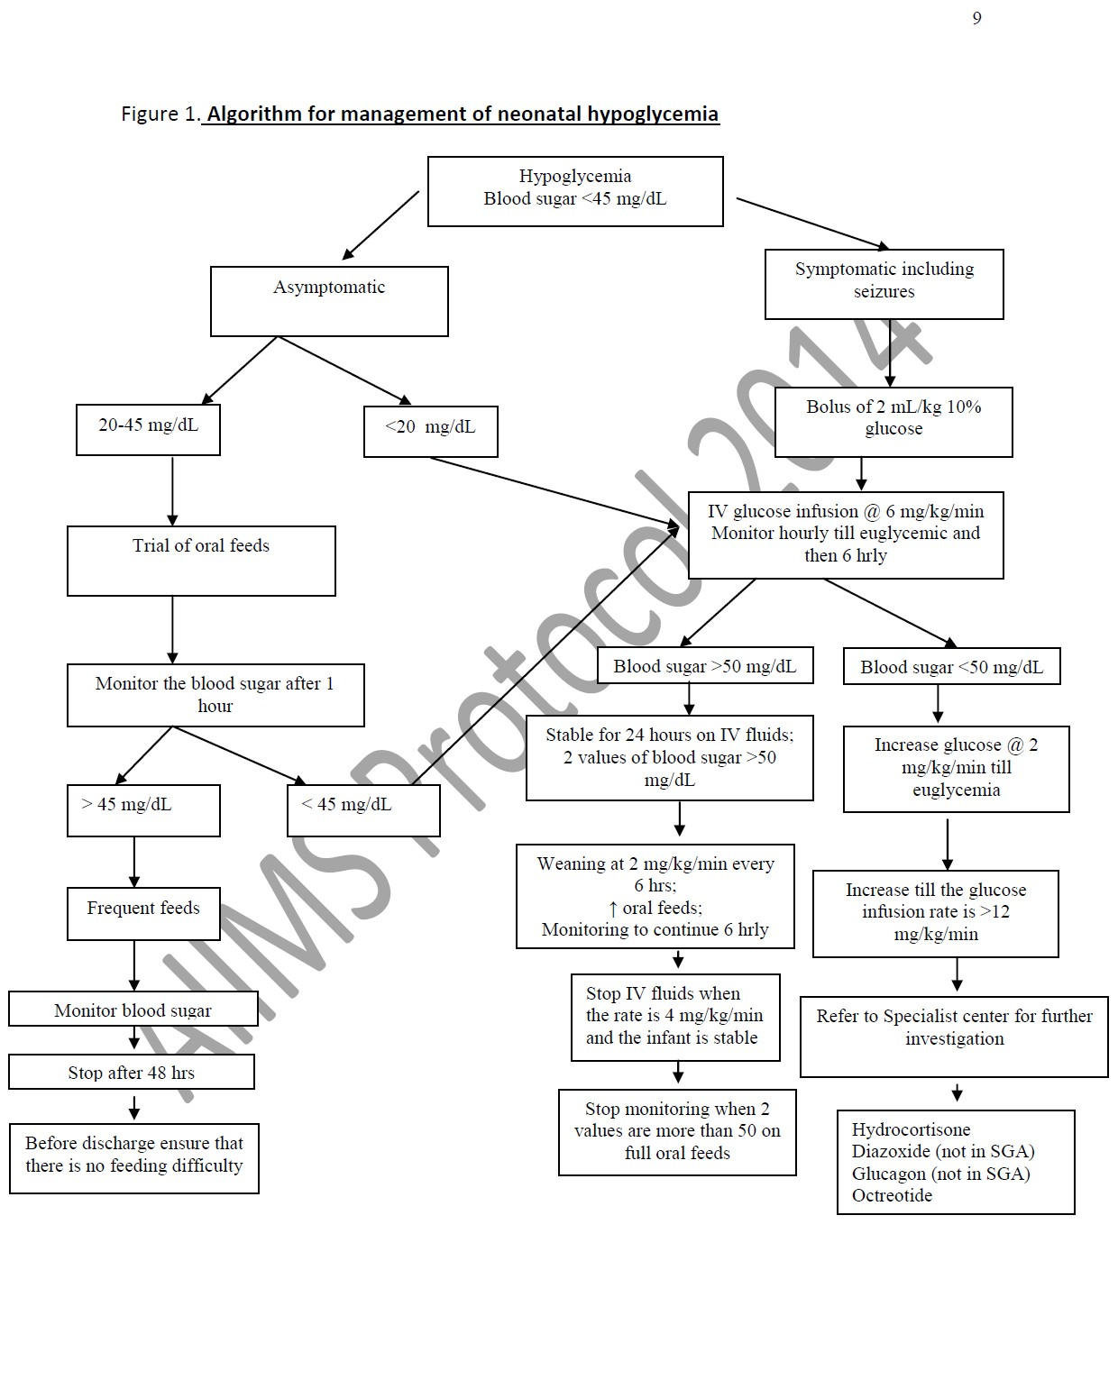
Management AIMS Protocol

Slide 26
Treatment
Hydrocortisone: 5 mg/kg/day iv q 12 hrly
↓Peripheral glucose utilization, ↑gluconeogenesis and effect
of glucagon.
Glucagon: 0.025-0.2 mg/kg iv/im/sc. Max- 1 mg.
Increase glucose release
Temporary measure and can be used in infants with good glycogen stores.
Diazoxide: 5-8 mg/kg/day q 8-12 hrly.
Inhibit insulin release
Octreotide: 5-20 mcg/kg/day iv/sc q 6-8 hrly.
Inhibit insulin secretion, can be used when diazoxide does not
successfully control BGL.
Subtotal pancreatectomy

Slide 27
Long term follow up and evaluation
MRI Scan : Typical pattern of CNS injury particularly in parieto-occipital cortex and sub cortical white matter.
Neonates have developmental delay, cerebral palsy, motor impairment, blindness and hearing impairement..
Babies who have had symptomatic hypoglycemia should have close follow up at 3, 6, 9, 12 & 18 month age for growth, neurodevelopment, vision and hearing loss.

Slide 28
HYPOCALCEMIA
DEFINITION:
Hypocalcemia is defined as total serum calcium of less than 7 mg/dL (1.75 mmol/L) or ionized calcium less than 4 mg/dL (1 mmol/L)
In very low birth weight infants the ionised calcium levels of 0.8 to 1mmol/lit are common and not usually associated with clinical symptoms

Slide 29
TYPES OF NEONATAL HYPOCALCEMIA
The early onset hypocalcemia:
presents within 72 h requires treatment with calcium supplementation for at least 72 h.
late onset hypocalcemia:
usually presents after 7 days and requires longer term therapy.

Slide 30
CAUSES OF EARLY ONSET HYPOCALCEMIA
Prematurity
Preeclampsia
Infant of Diabetic mother
Perinatal stress/ asphyxia
Maternal intake of anticonvulsants
(phenobarbitone, phenytoin sodium)
Maternal hyperparathyroidism
Iatrogenic (alkalosis, use of blood products, diuretics, phototherapy, lipid infusions etc

Slide 31
CLINICAL FEATURES
Asymptomatic
Symptomatic:
a) Neuromuscular irritability,Myoclonic jerks
Jitteriness,Exaggerated startle Seizures
b)Cardiac involvement:Tachycardia,prolonged QT
Interval,decreased contractility,
c)Other symptoms like
apnea,cyanosis,tachypnea,laryngospasm are noted

Slide 32
Diagnosis
Laboratory: By measuring total or ionised serum calcium
Ionised calcium is preferred mode for measuring hypocalcemia
ECG: QoTc>0.22 seconds or QTc>0.45 sec
QoT is measured from origin of q to origin of t wave
QT is measured from origin of q wave to end of t wave

Slide 33
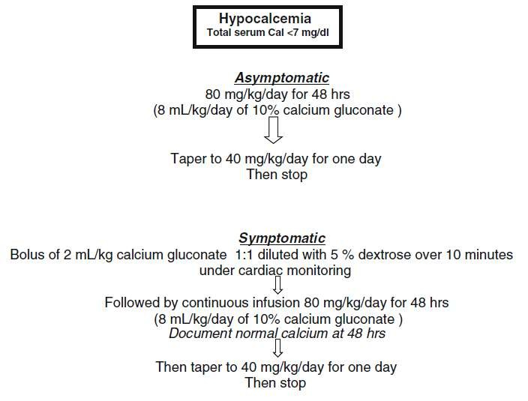
Management of EOH

Slide 34
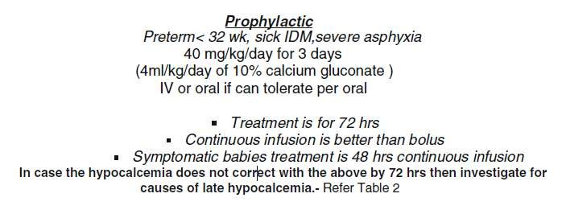

Slide 35
Side effects of calcium:
Bradycardias
Arrythmias
Skin and subcutaneous tissue necrosis may occur due to
extravasation
Hepatic necrosis may occur if tip of uvc lies in branch
of portal vein

Slide 36
LATE ONSET NEONATALHYPOCALCEMIA
presents at the end of the first wk of life. It is usually symptomatic in the form of neonatal tetany or seizures.
This is usually caused by high phosphate intake (iatrogenic).

Slide 37
CAUSES OF LATE ONSET HYPOCALCEMIA
Increased phosphate load
Cow milk, renal insufficiency
Hypomagnesemia
Vitamin D deficiency
Maternal vitamin D deficiency
Malabsorption
Renal insufficiency
Hepatobiliary disease
PTH resistence
Transient neonatal pseudohypoparathyroidism

Slide 38
Hypoparathyroidism
Primary
Hypoplasia, aplasia of parathyroid glands - (Di George’s
syndrome), CATCH 22 syndrome ,activating mutations of calcium
sensing receptor
Secondary
Maternal hyperparathyroidism
Metabolic Syndromes
Kenny-caffey syndrome
Long-chain fatty acyl CoA dehydrogenase deficiency
Kearns-sayre syndrome

Slide 39
Iatrogenic
Citrated blood products, Lipid infusions, Bicarbonate therapy
Diueretics, Glucocorticosteriods Phosphate therapy ,
Alkalosis
Phototherapy

Slide 41
Thank you

